Slide 1

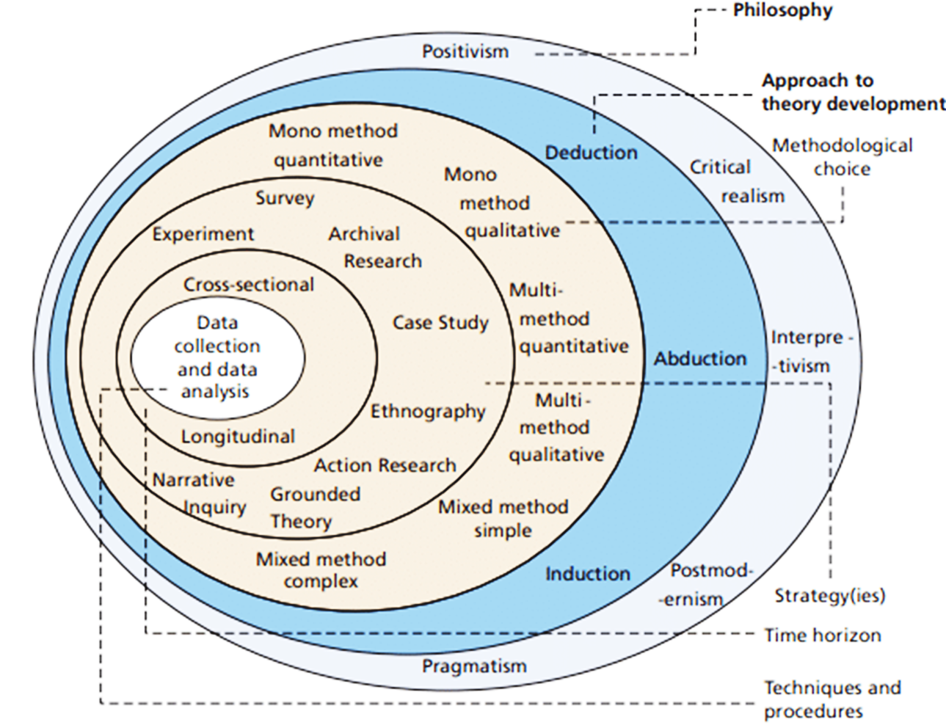
Research Onion
Prof. Pravin Kumar
Ph.D. (IITD), Operations and Supply Chain Management
Dept. of Mechanical Engineering
DTU, Delhi

Slide 2
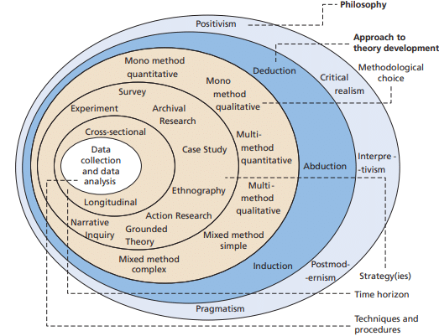
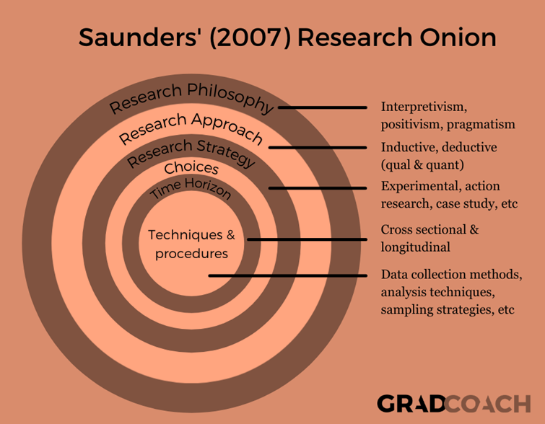
Research Onion

Slide 3
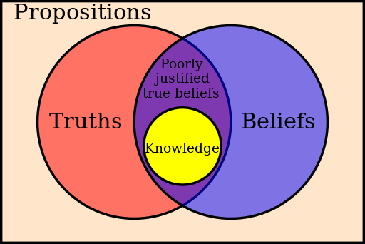
Research Philosophy
Set of beliefs the research is built upon.
Ontological or
Epistemology
Axiology
Ontology concerns the nature of being and reality, asking "What exists?".
Epistemology is the theory of knowledge, asking "How do we know?" or "What can we know?".
Axiology is the study of value, asking "What is good or valuable?" and concerning ethics and aesthetics.

Slide 4
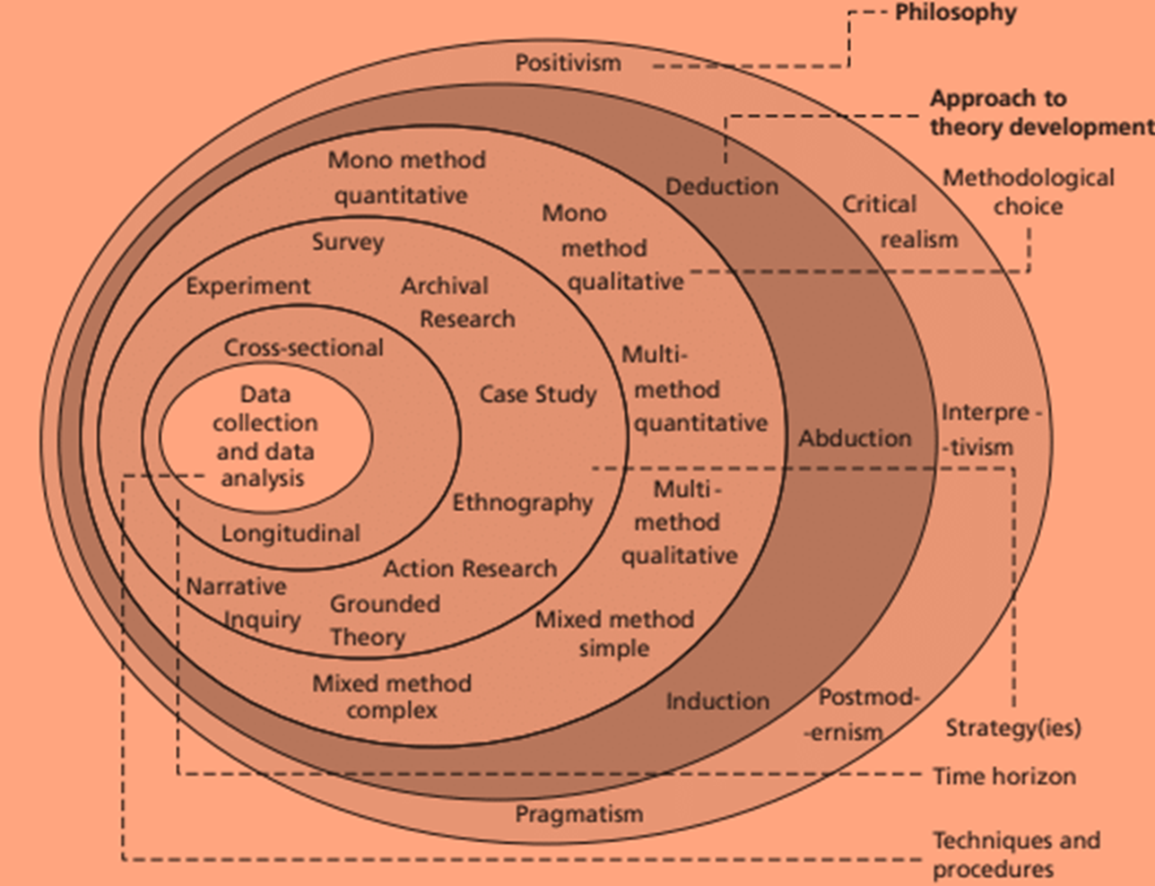
Three Philosophies
Three of the main research philosophies that operate on different ontological and epistemological assumptions:
Positivism
Interpretivism
Pragmatism

Slide 5
Research Philosophy 1: Positivism
Positivist research assumes an objective reality best understood through quantitative, scientific methods to find universal laws
Cannot include opinions or personal viewpoints – the researcher doesn’t interpret, they only observe.
There is only one reality and that all meaning is consistent between subjects.
Knowledge can only be acquired through empirical research, which is based on measurement and observation.
Knowledge can only be true, false, or meaningless.

Slide 6
Research Philosophy 2: Interpretivism
Interpretivism posits multiple subjective realities, emphasizing qualitative methods to understand individual meanings and context
emphasizes the influence that social and cultural factors can have on an individual.
Focuses on people’s thoughts and ideas, in light of the socio-cultural backdrop.
The researcher plays an active role in the study, as it’s necessary to draw a holistic view of the participant and their actions, thoughts and meanings.

Slide 7
Research Philosophy 3: Pragmatism
Pragmatism accepts that reality can be understood in multiple ways, allowing for a combination of perspectives rather than sticking to a single truth.
Approaches research from a practical point of view, the knowledge is not fixed, but instead is constantly questioned and interpreted.
Consists of an element of researcher involvement and subjectivity, specifically when drawing conclusions based on participants’ responses and decisions.
Not committed to (or limited by) one specific philosophy.

Slide 8
Research Philosophy 3: Pragmatism
This experiment can be altered, including details such as the one person or the group of people being family members or loved ones.
The fact that the experiment can be altered to suit the researcher’s needs is an example of pragmatism.
The outcome of the person doing the thought experiment is more important than the philosophical ideas behind the experiment.

Slide 9
Research Philosophy 4: Critical Realism
Critical Realism (CR) is a branch of philosophy that distinguishes between the 'real' world and the 'observable' world.
Critical realism is a philosophical approach that bridges the gap between the natural and social sciences, offering a compelling framework for understanding reality, …

Slide 10
Research Philosophy 5: Postmodernism
Postmodernism is a term used to refer to a variety of artistic, cultural, and philosophical movements that claim to mark a break from modernism.
They have in common the conviction that it is no longer possible to rely upon previous ways of depicting the world.

Slide 11

Onion Layer 2: Research Approach
Inductive approaches entail generating theories from research, rather than starting a project with a theory as a foundation.
Deductive approaches, on the other hand, begin with a theory and aim to build on it (or test it) through research.
An inductive approach could be used in the study of an otherwise unknown isolated community. There is very little knowledge about this community, and therefore, research would have to be conducted to gain information on the community, thus leading to the formation of theories.
A deductive approach would be taken when investigating changes in the physical properties of animals over time, as this would likely be rooted in the theory of evolution. In other words, the starting point is a well-established pre-existing body of research.

Slide 12
Onion Layer 2: Research Approach
Abductive reasoning starts with observations to infer the most likely, plausible explanation for those observations.
To generate a plausible hypothesis when faced with surprising or incomplete data.
The "best available" or "most likely" explanation for the observations.

Slide 13
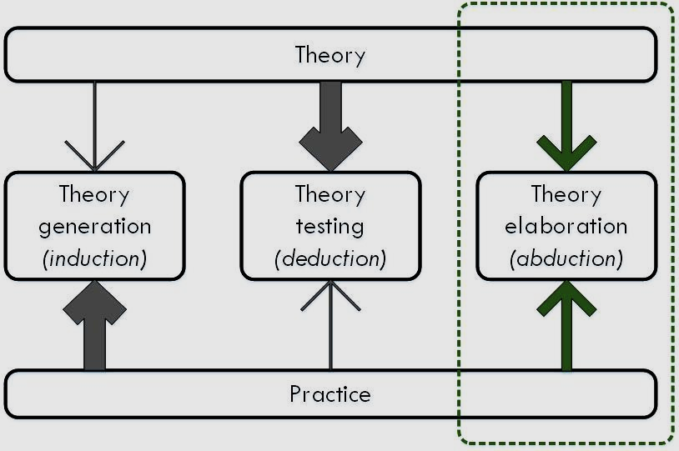
Onion Layer 2: Research Approach

Slide 14
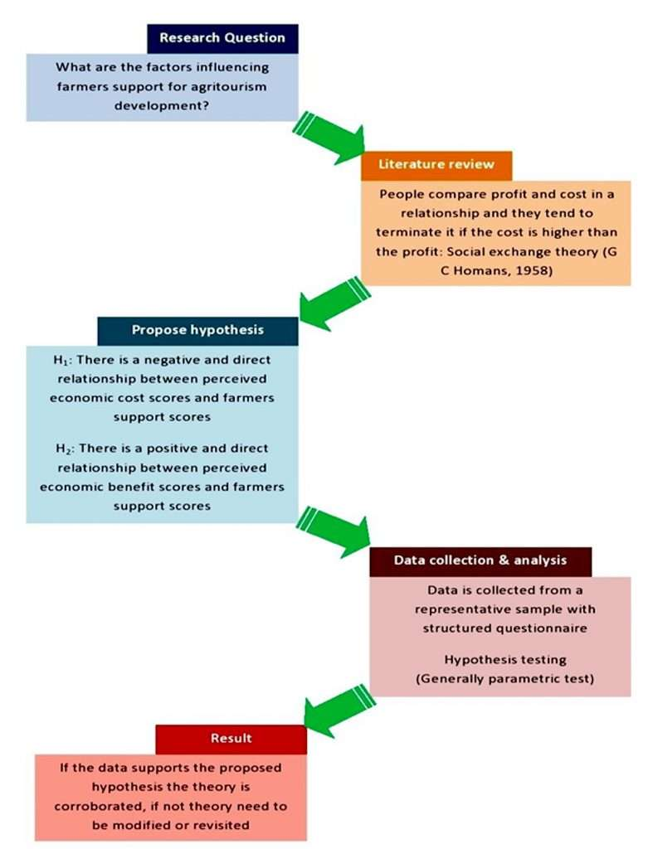
Schematic representation of deductive approach to research

Slide 15
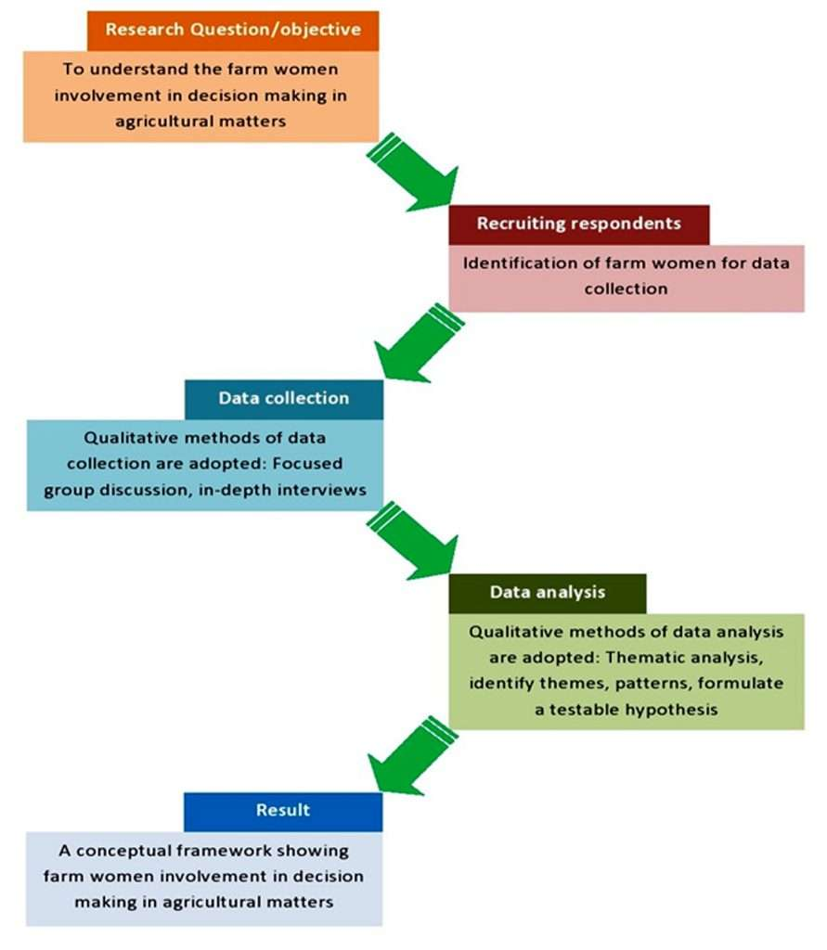
Schematic representation of inductive approach to research

Slide 16
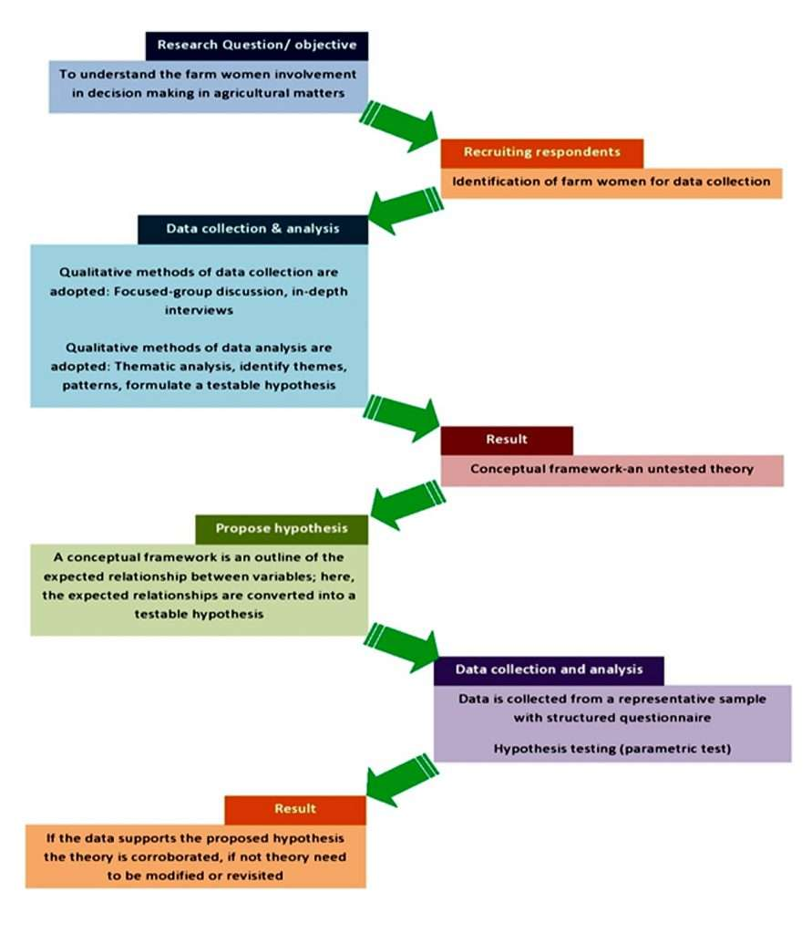
Schematic representation of abductive approach to research

Slide 17

Onion Layer 2: Research Approach
Qualitative research focuses on textual, visual or audio-based data, while quantitative research focuses on numerical data.
Generally, Inductive approaches are used within qualitative research, while quantitative research tends to reflect a deductive approach, informed by positivist philosophy.

Slide 18

Onion Layer 3: Research Strategy
Experimental research
Action research
Case study research
Grounded theory
Ethnography
Archival research

Slide 19
Strategy 1: Experimental research
Experimental research involves manipulating one variable (the independent variable) to observe a change in another variable (the dependent variable) – in other words, to assess the relationship between variables.
The purpose of experimental research is to support, refute or validate a research hypothesis. This research strategy follows the principles of the scientific method and is conducted within a controlled environment or setting (for example, a laboratory).
Experimental research aims to test existing theories rather than create new ones, and as such, is deductive in nature.
Experimental research aligns with the positivist research philosophy, as it assumes that knowledge can only be studied objectively and in isolation from external factors such as context or culture.

Slide 20
Strategy 2: Action research
Action research is conducted in practical settings such as a classroom, a hospital, a workspace, etc – as opposed to controlled environments like a lab.
Action research helps to inform researchers of problems or weaknesses related to interactions within the real-world.
With action research, there’s a strong focus on the participants (the people involved in the issue being studied, which is why it’s sometimes referred to as “participant action research”

Slide 21
Strategy 3: Case study research
The objective here is to gain an in-depth understanding within the context of the study – not (necessarily) to generalise the findings.
It is vital that, when conducting case study research, you take the social context and culture into account, which means that this type of research is (more often than not) qualitative in nature and tends to be inductive.
Also, since the researcher’s assumptions and understanding play a role in case study research, it is typically informed by an interpretivist philosophy.

Slide 22
Strategy 4: Grounded theory
Grounded theory is a qualitative research method where a theory is systematically developed from empirical data, rather than starting with a hypothesis.
Developed by sociologists Barney Glaser and Anselm Strauss, it involves an iterative, cyclical process of data collection and analysis, allowing themes and patterns to emerge naturally from real-world situations to form a new theory.
It's used to understand social processes and phenomena that are not yet well understood.

Slide 23
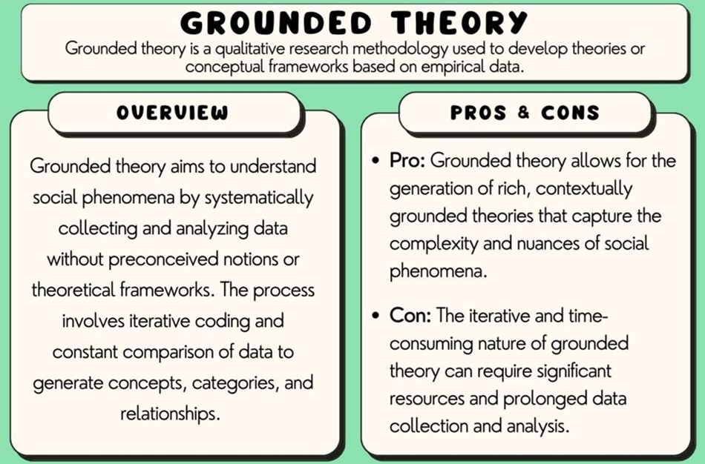

Slide 24
Strategy 5: Ethnography
Ethnography involves observing people in their natural environments and drawing meaning from their cultural interactions.
The objective with ethnography is to capture the subjective experiences of participants, to see the world through their eyes.
Creswell (2013) says it best: “Ethnographers study the meaning of the behaviour, the language, and the interaction among members of the culture-sharing group.”

Slide 25
Strategy 5: Ethnography
For example, if you wanted to explore the behaviour, language, and beliefs of an isolated Amazonian tribe, ethnography could allow you to develop a complex, complete description of the social behaviours of the group by immersing yourself into the community, rather than just observing from the outside.
It generally reflects an interpretivist research philosophy and involves an inductive, qualitative research approach.

Slide 26
Strategy 6: Archival research
An archival research strategy draws from materials that already exist, and meaning is then established through a review of this existing data.
This method is particularly well-suited to historical research and can make use of materials such as manuscripts and records.
For example, if you were interested in people’s beliefs about so-called supernatural phenomena in the medieval period, you could consult manuscripts and records from the time, and use those as your core data set.

Slide 27
Strategy 7: Narrative inquiry
Narrative inquiry is a qualitative research methodology focused on understanding human experience by studying the stories people tell about their lives.
Rather than seeking objective truths, it explores the subjective meanings, contexts, and relationships within those lived experiences.
Researchers collect narratives through methods like interviews or journals and then collaboratively interpret them with participants to reveal insights into identity, knowledge, and the humanness of care or other human experiences.

Slide 28
Onion Layer 4: Choices
Choosing to use a mono method means that you’ll only make use of one data type – either qualitative or quantitative.
If you were to make use of both quantitative and qualitative data, you’d be taking a mixed-methods approach.
With a multi-method approach, you’d make use of a wider range of approaches, with more than just a one quantitative and one qualitative approach.
For example, if you conduct a study looking at archives from a specific culture, you could make use of two qualitative methods (such as thematic analysis and content analysis), and then additionally make use of quantitative methods to analyse numerical data.

Slide 29
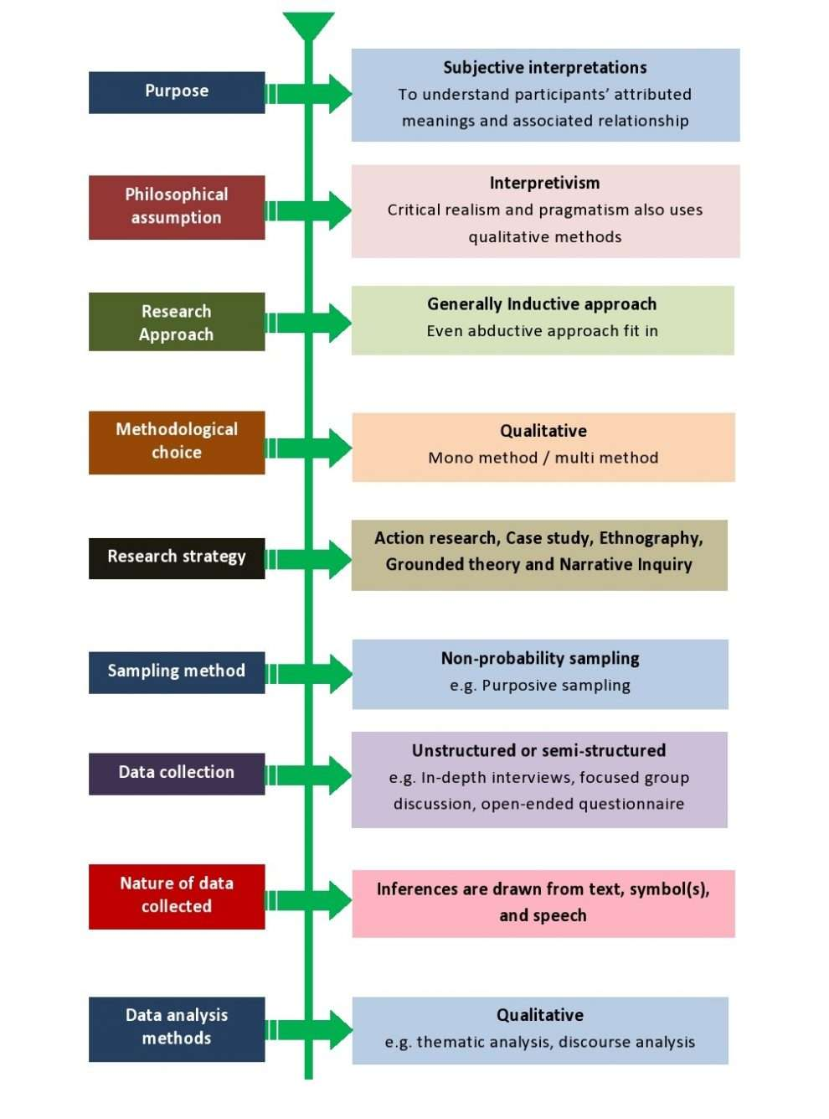
Schematic representation of qualitative research design

Slide 30
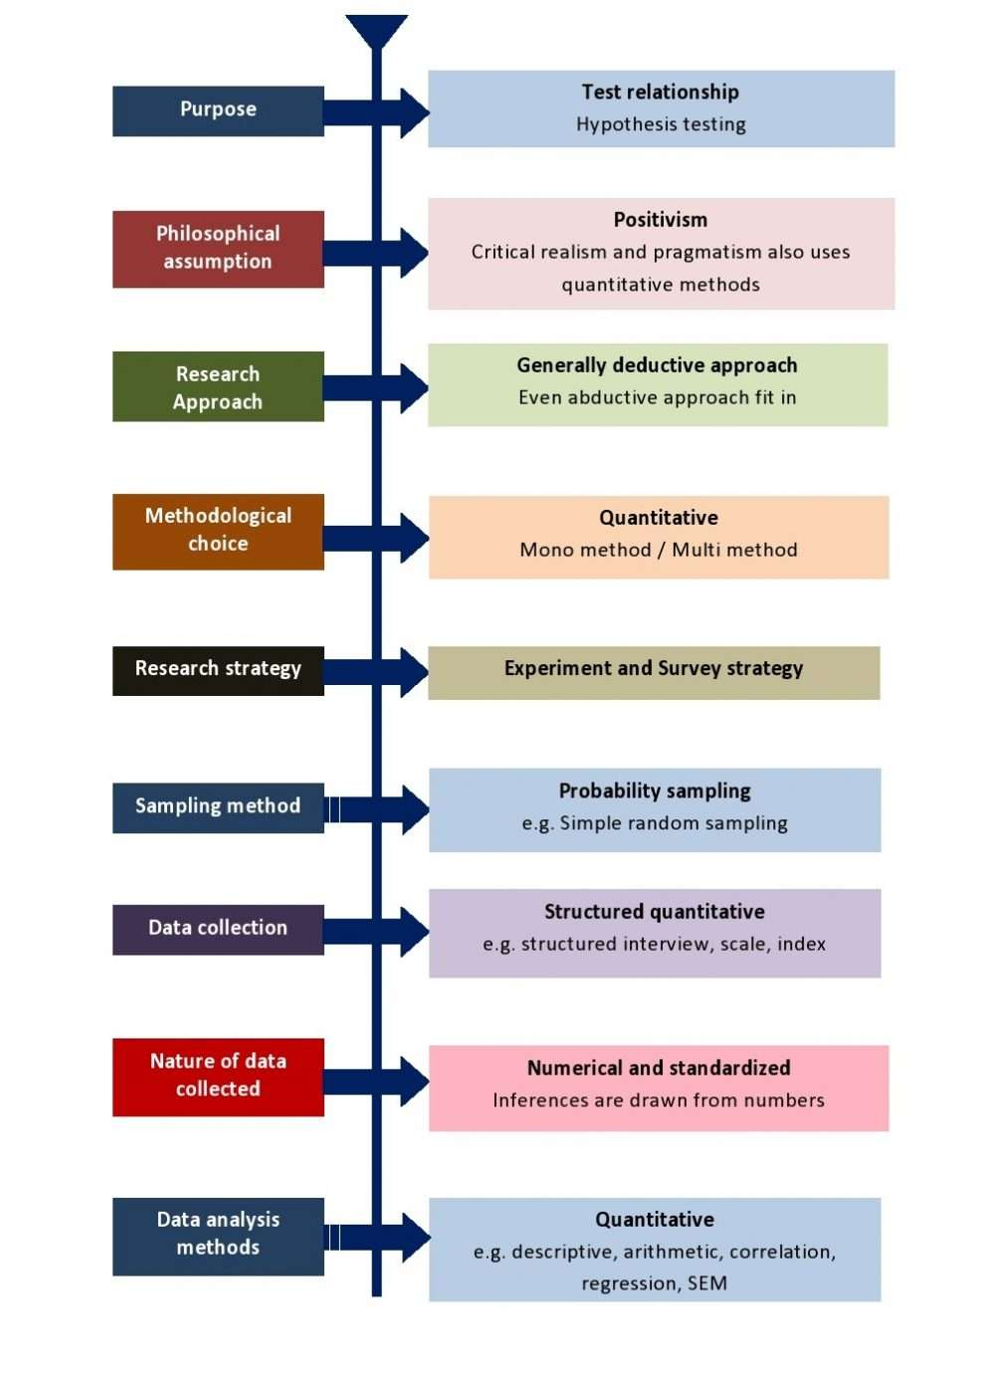
Schematic Representation of Quantitative Research Design

Slide 31
Onion Layer 5: Time horizon
The time horizon simply describes how many points in time you plan to collect your data at. Two options exist – the cross-sectional and longitudinal time horizon.
Imagine that you’re wasting time on social media and think, “Ooh! I want to study the language of memes and how this language evolves over time”. For this study, you’d need to collect data over multiple points in time – perhaps over a few weeks, months, or even years. Therefore, you’d make use of a longitudinal time horizon.
If instead, you wanted to study the language used in memes at a certain point in time (for example, in 2020), you’d make use of a cross-sectional time horizon. This is where data is collected at one point in time, so you wouldn’t be gathering data to see how language changes, but rather what language exists at a snapshot point in time.

Slide 32
Onion Layer 6: Techniques and Procedures
Decide on what data you’ll collect and what data collection methods you’ll use (for example, will you use a survey? Or perhaps one-on-one interviews?)
Decide how you’ll go about sampling the population (for example, snowball sampling, random sampling, convenience sampling, etc).
Snowball sampling is a non-probability research technique where initial participants refer the researcher to other individuals who meet the study's criteria, causing the sample to grow like a snowball rolling down a hill.
Determine the type of data analysis you’ll use to answer your research questions (such as content analysis or a statistical analysis like correlation).
Set up the materials you’ll be using for your study (such as writing up questions for a survey or interview)

Slide 33
Data collection
Data type: Choose between primary and secondary data, and qualitative and quantitative data
Data source: Collect data from different sources
Data accuracy: Ensure data is accurate and honest
Data collection instruments: Select appropriate instruments and instructions for their use

Slide 34
Data analysis
Data interpretation: Analyze the data to answer research questions
Data evaluation: Evaluate the outcomes of the research

Slide 35
Thanks

